Slide 1
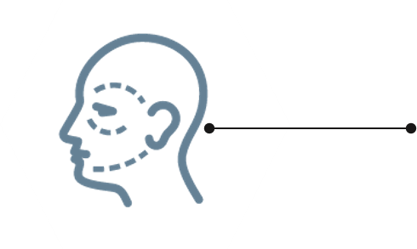
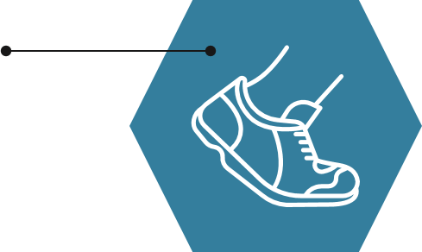

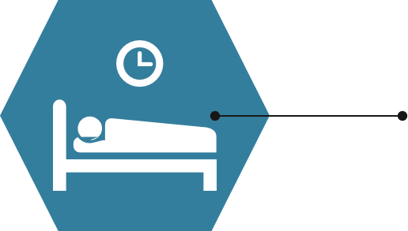
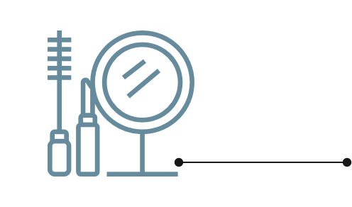

1
Lead-in
Physical appearance is sometimes important to you. If you want to change your looks, what can you do?
have/receive plastic surgery (整形手术)
take exercise
have more vegetables and fruit
have a good sleep
use cosmetics /kɑz'metɪks/
(化妆品)

Slide 2
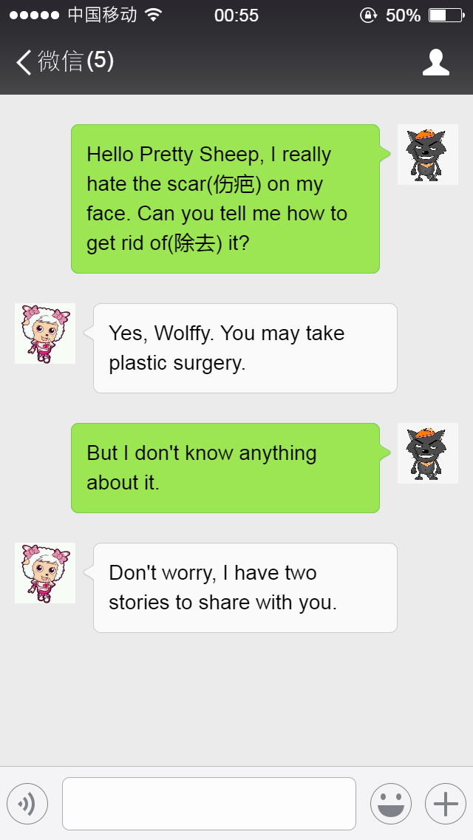
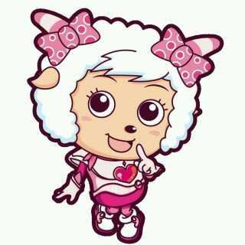


Step 2 Reading: Lead-in
Pretty Sheep
Hello Pretty Sheep, I really hate the scar on my face. Can you tell me how to get rid of(除去) it?
Yes Wolffy, you may take plastic surgery.
scar
疤痕
But I don’t know anything about that.
Don’t worry, I have two stories and tasks to share with you.
Wolffy
Pretty Sheep

Slide 3
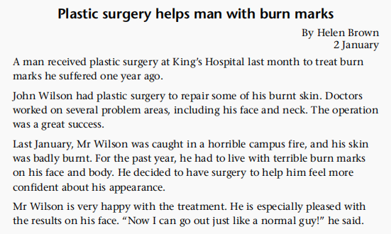
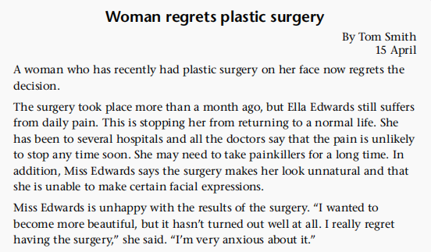
Analyse the structure of the TWO articles.
The lead
Detailed and background information about the surgery
Personal opinion about the surgery

Slide 4
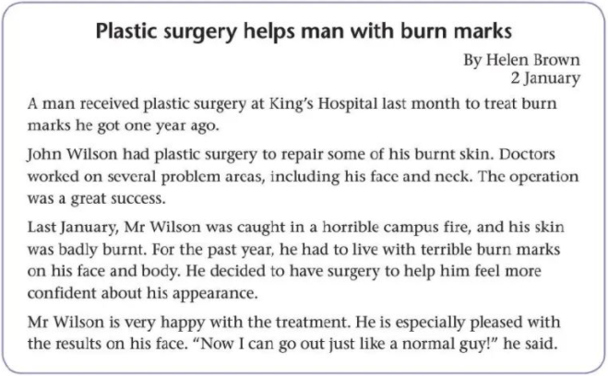
Reading for the main idea: The lead is the eye of a magazine article, which gives the most information of the news.
The first one mainly talks about a man who received ____________ last month and the __________ was a great success.
plastic surgery
operation

Slide 5
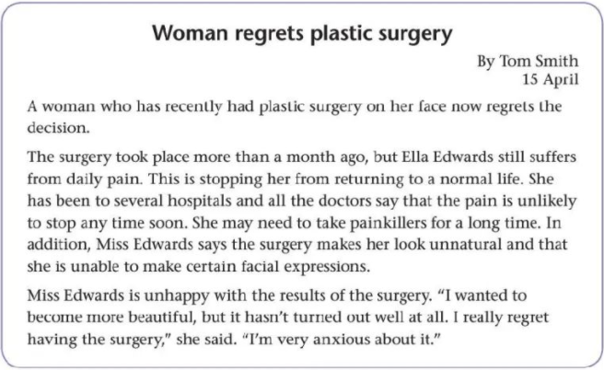
Reading for the main idea: The lead is the eye of a magazine article, which gives the most information of the news.
The second one mainly talks about a woman who had plastic surgery recently and she ________ the decision.
regrets

Slide 6
Reading for the body: The body gives more details of the article.
How did the plastic surgery help Mr. Wilson?
By repairing some of his burnt skin.
What problems did the plastic surgery bring to Miss Edwards?
She suffered from daily pain and had to take painkillers to stop it. The surgery made her look unnatural and unable to make some facial expressions.

Slide 7
Reading for accumulating expressions : causes, results and emotions concerning the plastic surgery.
Causes Results Emotions
• be caught
• be badly hurt
• live with terrible burn marks
• a great success
• go out like a normal guy
• feel more confident
• be pleased with
• want to become more beautiful
• not turn out well at all
• suffer from daily pain
• stop her from returning to a normal life
• (the pain) be unlikely to stop
• make her look unnatural
• be unable to make certain facial expressions
• be unhappy
• regret doing

Slide 8
Plastic surgery helps man with burn marks
By Helen Brown
2 January
A man received plastic surgery at King's Hospital last month to treat burn marks he got one year ago.
John Wilson had plastic surgery to repair some of his burnt skin. Doctors worked on several problem areas, including his face and neck. The operation was a great success.
整容手术
v.治疗
烧伤印记
that
have sth. to do 使sth.怎么样
操作
n.手术；操作

Slide 9
陷入了…
n.校园
Last January, Mr Wilson was caught in a horrible campus fire, and his skin was badly burnt. For the past year, he had to live with terrible burn marks on his face and body. He decided to have surgery to help him feel more confident about his appearance.
Mr Wilson is very happy with the treatment. He is especially pleased with the results on his face. "Now I can go out just like a normal guy!" he said.
have sth. to do 使sth.怎么样
对…满意
外出
n.小伙子

Slide 10
Woman regrets plastic surgery
By Tom Smith
15 April
A woman who has recently had plastic surgery on her face now regrets the decision.
The surgery took place more than a month ago, but Ella Edwards still suffers from daily pain. This is stopping her from returning to a normal life. She has been to several hospitals and all the doctors say that the pain is unlikely to stop any time soon.
主句
定语从句
A woman has recently had….
发生
遭受
阻止某人做…
回到
已经去过…
不可能做…

Slide 11
吃止痛药
另外
She may need to take painkillers for a long time. In addition, Miss Edwards says the surgery makes her look unnatural and that she is unable to make certain facial expressions.
Miss Edwards is unhappy with the results of the surgery. "I wanted to become more beautiful, but it hasn't turned out well at all. I really regret having the surgery," she said. " I’m very anxious about it.
adj.特定的
证明是/结果是/原来是..
regret doing后悔做…

Slide 12

What advantages(好处)does plastic surgery have according to Mr. Wilson?
(1)_________ his burnt skin;
(2)Helping him feel more ___________ about his appearance.
Repairing
confident
What disadvantages(坏处) does plastic surgery have according to Miss Edwards?
She still suffers from _________ _________ and is unable to make certain _________ _________.
daily
pain
facial
expressions

Slide 13


I’m still confused(困惑的). It seems that plastic surgery has both advantages and disadvantages. I need more information.
Good afternoon everyone, our reporter Alice is going to report on plastic surgery...

Slide 14

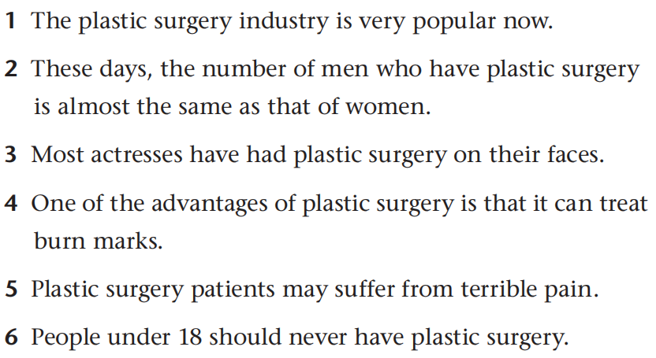
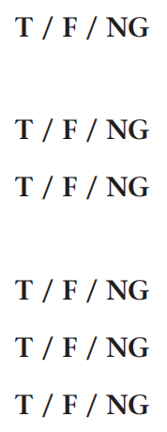
04
Reason ( While-listening)
Look through the statements of part B1 and circle the key information.

Slide 15
3
Listening for the first time
Look through these sentences, try to predict what aspects will be talked about.
Phenomenon
Advantages
Disadvantages
Advice

Slide 16

04
Reason ( While-listening)
Look through the statements of part B1 and circle the key information.
about one third of all patients.
Predict the answer________________.
Doctors strongly advise against plastic surgery for people under 18 unless it is necessary, for example, to treat burn marks.

Slide 17
06
06
Listening
Listening for the blanks
Listening
more and more popular
Plastic surgery is undoubtedly becoming . Every year, millions of people decide to have plastic surgery to change their looks. Surprisingly, about ________of all plastic surgery patients are . The average age of patients is and experts believe the industry will only continue to in the future.
Many people see it as the easiest way to help improve their , like burn marks or unhappy with their looks. By improving their appearance, it build their
_____________ .
Plastic surgery is very . In addition, it carries serious . Patients may suffer health problems after failed plastic surgery operations or even die during operations. Finally, the results might not be what people . This is especially true for ________.
Before deciding whether or not to have plastic surgery, remember: think before you act.
one third
man
falling
grow
appearance
self-confidence
expensive
health risks
expect
teenagers

Slide 18
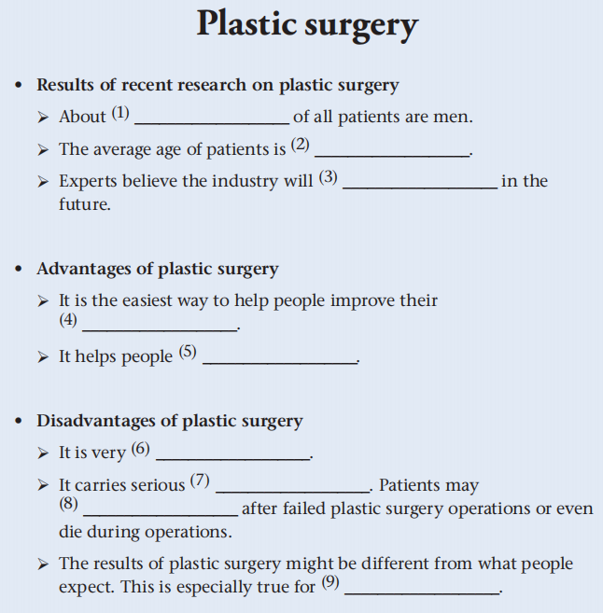
3
Listening for the second time
one third
falling
continue to grow
appearance
build their self-confidence
expensive
health risks
suffer health problems
teenagers

Slide 19
Transcript
However, it’s also important to consider the disadvantages. Plastic surgery is very expensive. In addition, any kind of surgery carries serious health risks. Patients may suffer health problems after failed plastic surgery operations. In some extreme cases, patients may even die during operations. Finally, the results of plastic surgery might not be what people expect. This is especially true for teenagers, as their bodies are still growing. Doctors strongly advise against plastic surgery for people under eighteen unless it is necessary, for example, to treat burn marks.
It is important to weigh up all of the advantages and disadvantages before deciding whether or not to have plastic surgery. Remember: think before you act.
Alice: Hello! My name is Alice and today I’m reporting on the plastic
surgery industry. Plastic surgery is undoubtedly becoming more and more popular. Every year, millions of people decide to have plastic surgery to change their looks. You might think only women want plastic surgery, but recent research shows that, surprisingly, about one third of all plastic surgery patients are men. The average age of patients is falling and experts believe the industry will only continue to grow in the future.
Then why is plastic surgery so popular these days? Many people see it as the easiest way to help improve their appearance. Some of these patients have obvious problems like burn marks, while others are just unhappy with their looks. By improving their appearance, plastic surgery can help people in both groups build their self-confidence.

Slide 20

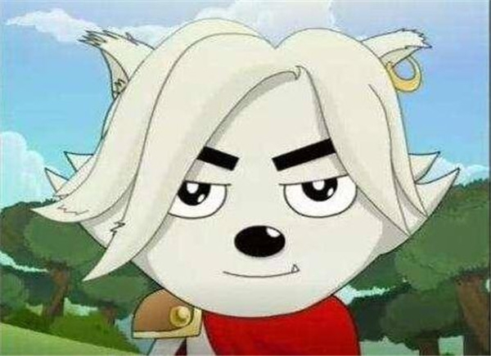
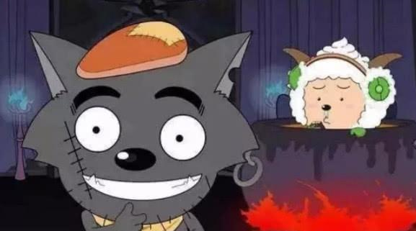
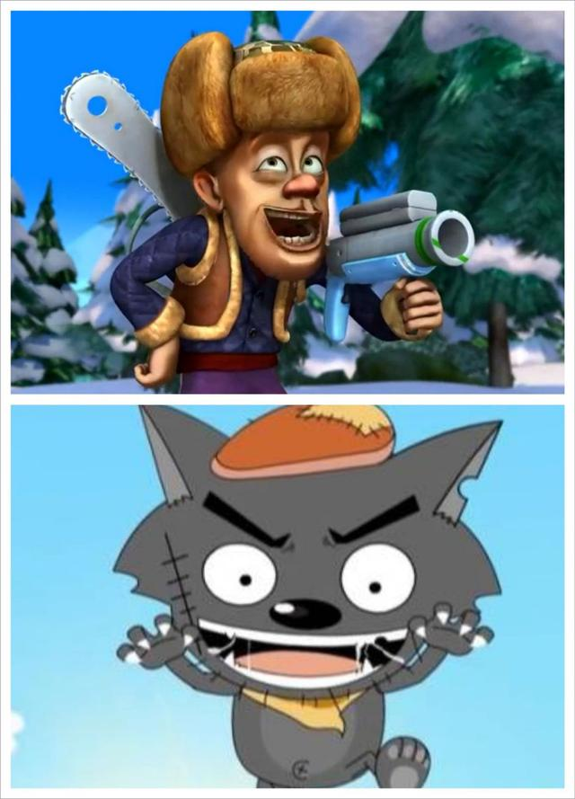
Task 3 Critical thinking
Finally, Wolffy took plastic surgery and became very handsome.
Q1. Do you think he would become popular just by changing his appearance? Why or why not?

Slide 21
Task 3 Critical thinking
Finally, Wolffy took plastic surgery and became very handsome.
Q2. What can we learn from Wolffy’s story?
Real beauty lies inside.
We should not judge a book by its cover.
不应以貌取人

Slide 22
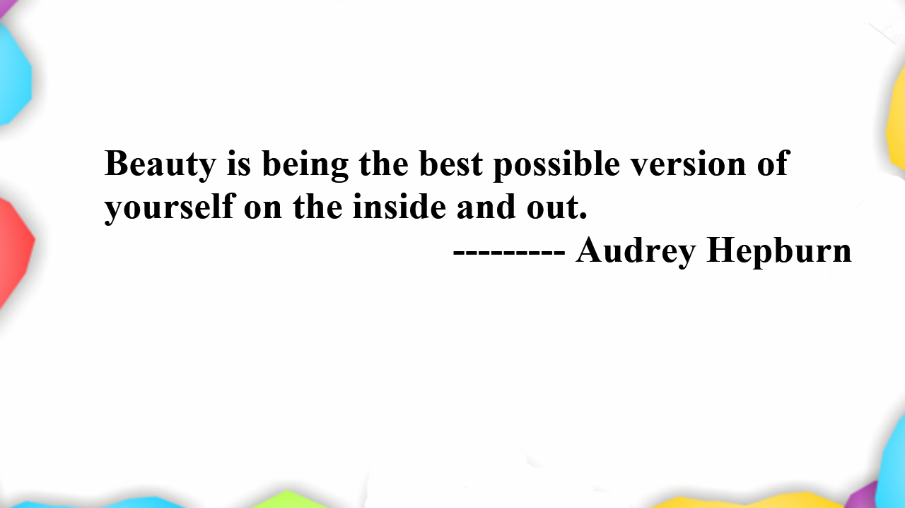
美是从内到外做最好的自己。
------------ 奥黛丽·赫本

